Slide 1

Why our product is the newest way to infuse your day
Presented by: Shadia and Shannon

Slide 2
Our brand
Inspiring. Indulging. These were the words that drove the development of INFUSE Bottle + Ball Pod. We wanted our bottle to be there when our customers were working hard – inspiring them to create change with our unique design and refreshing take on life. We wanted them to indulge; to treat themselves and still maintain an active lifestyle. And we wanted them to feel good about it – because INFUSE is good - for both body and mind.

Slide 3
Specifics about our bottle and pod
Our thermometer is digital so you know when your tea is at the perfect temperature for drinking.
The double layer of acrylic is strong, durable and thick enough to ensure that your tea will stay hot for at least 6 hours, or cold for at least 8.
our pod is free floating, allowing for maximum infusion unlike our competitors who’s pod is attached at the top of the bottle, which become unusable after the water gets to a certain level. Our pod is also made from 2 options. A light aluminum metal, that comes in a light grey or futuristic purple, or silicone rubber that comes in a variety of colours.

Slide 4
Colour options for everyone
Currently our bottles are offered in a limited number of colours, we are working to expand that line as necessary
The current available colours are: Cherry red, pine green, blueberry purple, pumpkin orange and orchid pink.
we want to ensure that everyone enjoys our products, so we’re geared towards making sure everyone can use and enjoy our water-bottles.

Slide 5
Our Base Product:

Slide 6
Target audience
Millennials
Those who enjoy working out
Hot yoga participants
Office workers/anyone who works long hours
Students
Anyone who likes to infuse their water

Slide 7

A BRIEF VIEW OF THE BOTTLE

Slide 8
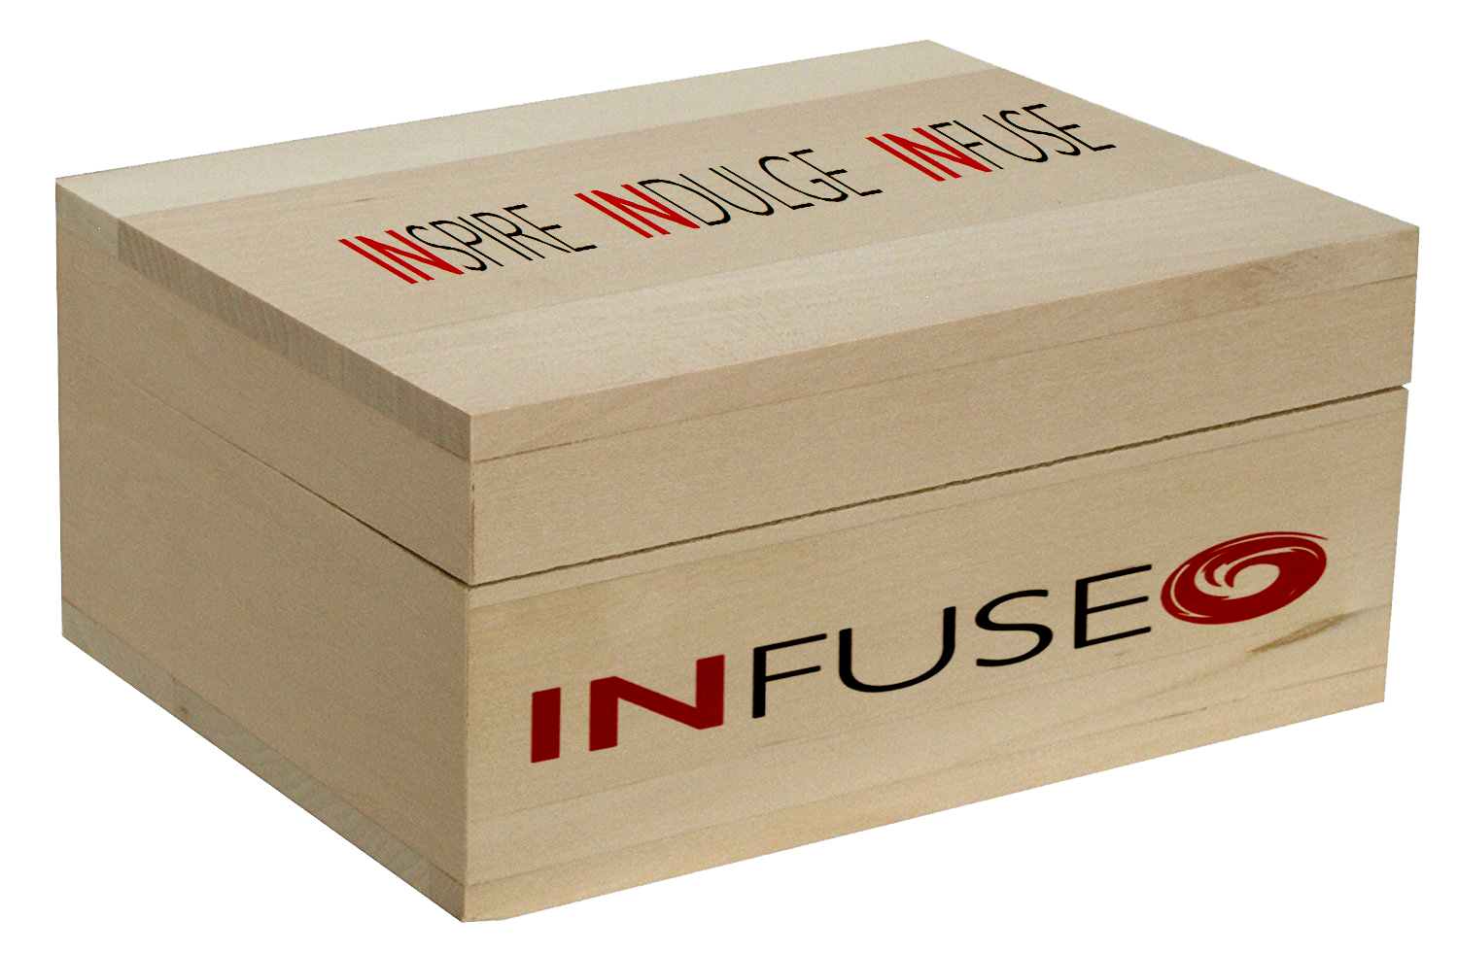
Unique Package
We want our product to stand out on the shelves during the holidays; which is why we’ve chosen to use a 100% recycled wood box for our packaging. Our logo has been burned into it so no printing errors or sticker removal to worry about.
This box holds more than just the water bottle. It has a section for a pod or two and spots for our other product that we’re sure you’re going to love.

Slide 9
Why a wooden box over cardboard?
Well it’s simple really, first it makes us stand out on the shelf. What is your eye going to be drawn too first? Another simple cardboard box with a picture of a bottle? Or the wooden box with a logo that’s been burned into the side and a slogan on the top?
The wooden box. It’s simplistic enough to be used for any and all occasions.
Boss’s birthday? Student graduating or starting school? Friend who can’t seem to find the right water bottle? This is the best gift you can give them.

Slide 10
Why recycled wood?
We know millennials today care about the environment and are becoming more and more aware that climate change Is happening. So we’ve chosen to make our packaging specifically from recycled wood, leaving the few forests we have left, alone to thrive and grow.
It doesn’t only look great, it’s reusable, and 100% biodegradable!

Slide 11
We also have a line of specialty teas
Are you tired of plain water? Do you need an extra boost to get you through the day? From school, work, yoga and everything in between we’ve got you covered.
Sold as single packets of loose leaf tea, we’ve made it our mission to provide out clients with different options depending on what they’re looking for.

Slide 12
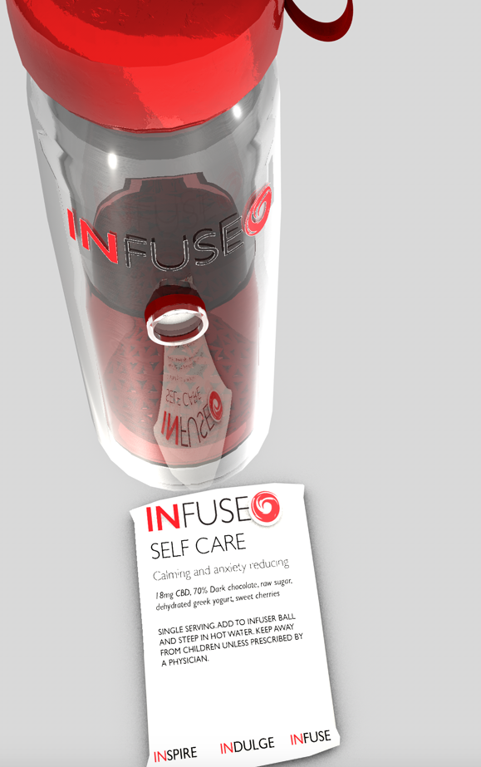
Self care
Are you a college or university student? Undergrad? Do you work in a high stress job? Have any form of anxiety or just had a rough day? This tea might just be what you need.
Made from 70% dark chocolate, raw sugar, dehydrated Greek yogurt and sweet cherries
It’s guaranteed to help relief stress and reduce anxiety

Slide 13
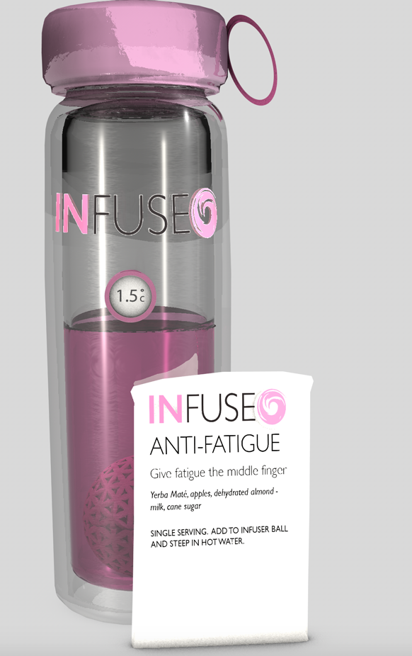
Anti-Fatigue
Stayed up too late trying to get that assignment done? Pull more overtime than you meant too? Kids keep you up? Fell in love with a book you just had to finish? Or was it a video game that you just lost track of time playing?
Don’t worry we’ve got your fix. Give fatigue the middle finger with our anti-fatigue tea!
Loose leaf made with yerba mate, apples, dehydrated almond-milk and cane sugar.

Slide 14
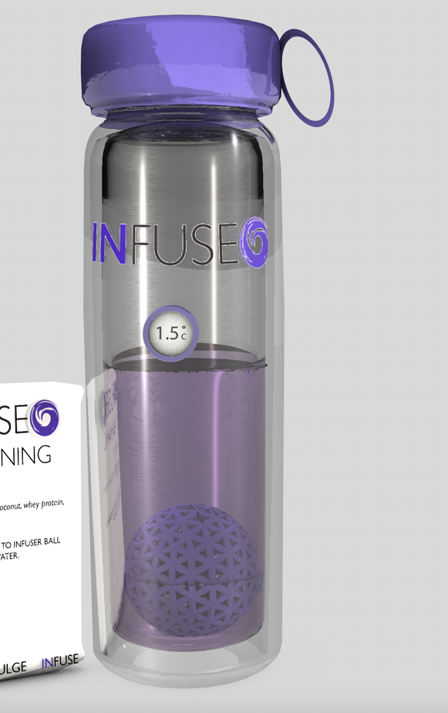
Fat Burning
“Burn Fat, be fit”
Ever feel like water is just becoming boring? But you need it to help stay hydrated after that work out or yoga session right? Well we’ve got a solution for that, our fat burning tea will help keep you hydrated as well as taste great while helping you to keep burning fat.
Loose leaf: Green tea, blueberries, coconut, whey protein, stevia, non-gmo

Slide 15
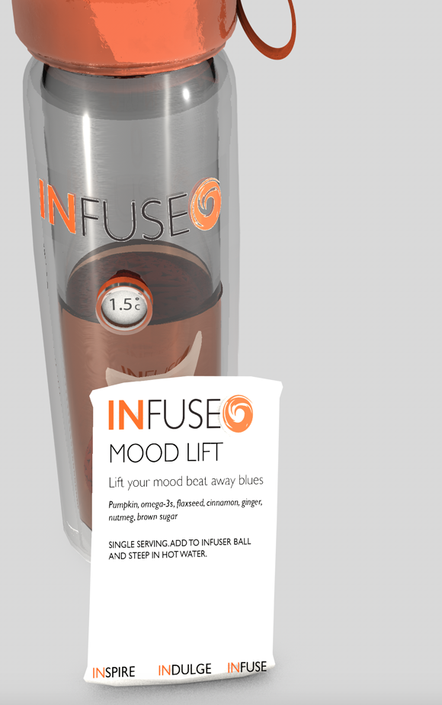
Mood lift
“Lift your mood, beat any blues”
If you’ve had a hard day, and just need a bit to get that smile back, this will help.
Made from: pumpkin, omega-3s, flaxseed, cinnamon, ginger, nutmeg, and brown sugar.

Slide 16
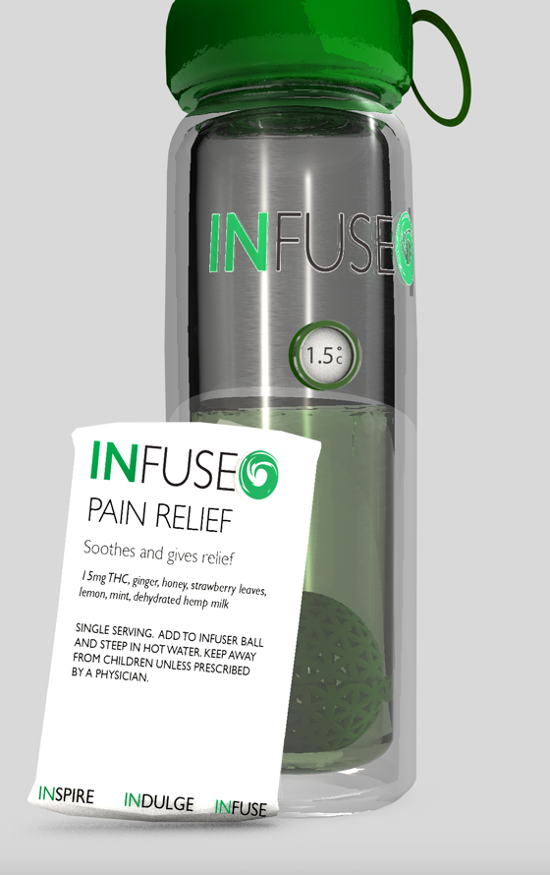
Pain relief
“Soothes and gives relief”
Work out too hard? Strain yourself at work or home? General aches and pain? Don’t worry we’ve got you covered!
With 15mg of thc, ginger, honey, strawberry leaves, lemon, mint, dehydrated hemp milk, you can drink this and keep that pain at bay.

Slide 17
Thank you for listening
Look for our products on a shelf near you soon!

